Slide 1
Sequence Category Data Types

Slide 2
Sequence Category Data Types
The purpose of Sequence Category Data Types is that "To Store Sequence of Values in single object".
=>We have 4 Data Types in Sequence Category. They are
1. str
2. bytes
3. bytearray
4. range

Slide 3
Sequence Cataegory Data type
Str-(string )
Bytes
Bytearray
Range

Slide 4
str
Index
What is str
Definition of str
Notations of str
Types of strs
Syntax for storing str data
Memory Management of str data
+Ve Indexing
-Ve Indexing
Operations on str data
Indexing
Slicing Operation
Programming Examples

Slide 5
Properties of str
'str' is one of the pre-defined class and treated as Sequence Data Type.
The purpose of str data type is that "To store String data or text data or Alphanumeric data or numeric data or special symbols within double Quotes or single quotes or tripple double quotes and tripple single quotes. "

Slide 6
Def. of str:
str is a collection of Characters or Alphanumeric data or numeric data or any type of data enclosed within double Quotes or single quotes or tripple double quotes and tripple single quotes.
There are two types if string data
1 -single line string data
2 – multiline string data

Slide 7
1. Single Line String Data:
Syntax1:- varname=" Single Line String Data " (OR)
Syntax2:- varname=' Single Line String Data '
=>With the help double Quotes (" ") and single Quotes (' ') we can store single line str data only but not possible to store multi line string data.

Slide 8
2. Multi Line String Data:
=>Syntax1:- varname=" " " String Data1 String Data2 ----------- --- String data-n " " ”
(OR)
=>Syntax2:- varname=' ' ' String Data1 String Data2 -----
---- --------- String data-n ' ' '

Slide 9
How to store multiline String Data
With the help tripple double Quotes (" " " " " ") and Tripple single Quotes (' ' ' ' ' ') we can store single line str data and multi line string data

Slide 10
Examples
>>> s1="Python"
>>> print(s1,type(s1))---------------------------Python <class 'str'>
>>> s2='Python'
>>> print(s2,type(s2))--------------------------Python <class 'str'>
>>> s3="A"
>>> print(s3,type(s3))--------------------------A <class 'str'>
>>> s4='A'
>>> print(s4,type(s4))-------------------------A <class 'str'>
>>> s1="123456“
>>> print(s1,type(s1))-------------------------123456 <class 'str'>
>>> s2="Python3.11“
>>> print(s2,type(s2))------------------------Python3.11 <class 'str'>
>>> s3="123$456_abc"
>>> print(s3,type(s3))------------------------123$456_abc <class 'str'>
>>> s4="@#$%^&8912“
>>> print(s4,type(s4))-------------------------@#$%^&8912 <class 'str'>
>>> s1="Python Programming"
>>> print(s1,type(s1))-----------------------Python Programming <class 'str'

Slide 11
Errors :-
>>> addr1="Guido Van Rossum ------------------------------ SyntaxError: unterminated string literal (detected at line 1)
>>> addr1=' Guido Van Rossum --------------------------------- SyntaxError: unterminated string literal (detected at line 1)

Slide 12
Store address :-
>>> addr1=" " "Guido Van Rossum
FNO:3-4, Hill Side
Python Software Foundation
Nether Lands-56 " " “
>>> print(addr1,type(addr1))
Guido Van Rossum
FNO:3-4, Hill Side
Python Software Foundation
Nether Lands-56 <class 'str'>

Slide 13
Store Address 2
>>> addr2= ' ' ' Travis Oliphant
HNO:12-34, Sea Side
Numpy Organization
Nether lands-58 ' ' '
>>> print(addr2,type(addr2))
Travis Oliphant
HNO:12-34, Sea Side
Numpy Organization
Nether lands-58 <class 'str'>

Slide 14
Others Example :-
>>>s1="""Python Programming""“
>>> print(s1,type(s1))------Python Programming <class 'str'>
>>> s1='''Python Programming'''
>>> print(s1,type(s1))------Python Programming <class 'str'>
>>> s2="""A"""
>>> print(s2,type(s2))----------------A <class 'str'>
>>> s2='''A'''
>>> print(s2,type(s2))---------------A <class 'str'>

Slide 15
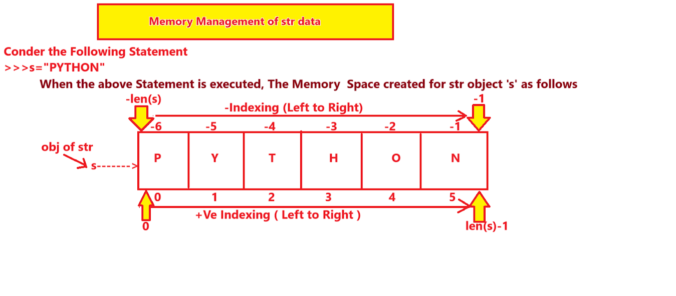
Memory management string data

